Slide 1
Respiratory Care Program Information Session
Full-Time & Part-Time Tracks
2026 Admission Cycle

Slide 2
Meet Our Respiratory Care Support Team
Department Chairperson, TBD
Dr. Pifher, DHSc, RRT-ACCS, RCP, Faculty, Program Coordinator
Ms. Barker, MSRT, RRT-NPS, RCP, Faculty, Clinic Coordinator
Ms. Greenawalt, RRT-ACCS, RCP, Faculty
Program Contact Info
  Union Hall 308 | 614-287-2521 | respiratory@cscc.edu www.cscc.edu/respiratory

Slide 3

What is a Registered Respiratory Therapist?
Registered Respiratory Therapists (RRTs) treat and assess patients with breathing and cardiopulmonary issues. They manage life support systems for premature babies and others who need assistance breathing from disease and trauma. RRTs also educate patients on conditions like asthma and COPD.

Slide 4

RRTs are Members of the Healthcare Team
Registered Respiratory Therapists (RRTs) do not work under nurses; rather, they are integral members of a collaborative healthcare team. RRTs bring specialized cardiopulmonary expertise that directly contributes to positive patient outcomes, and in many cases, their recommendations can mean the difference between life and death.

Slide 5
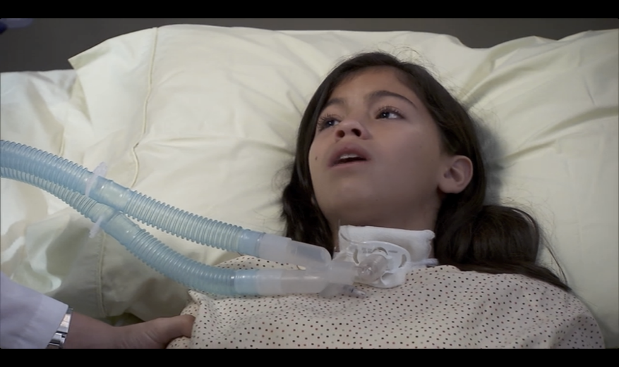
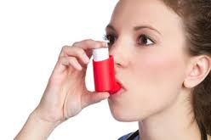
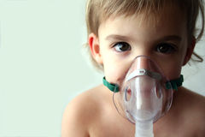
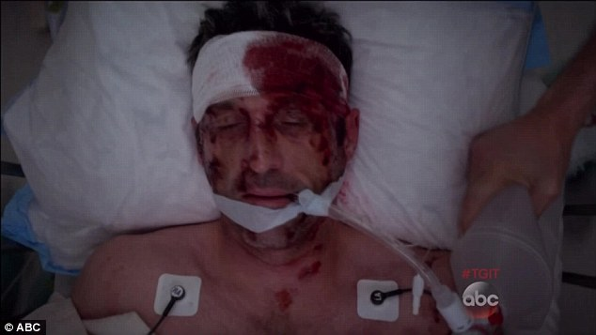
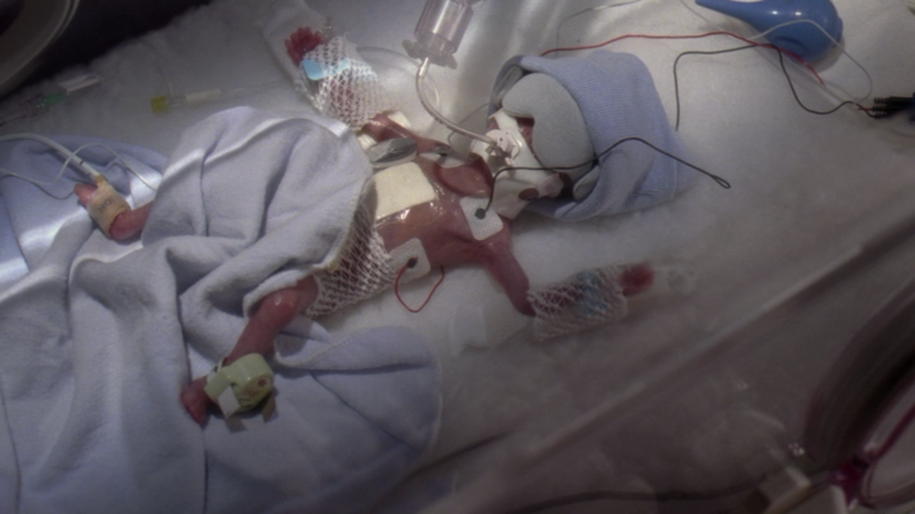
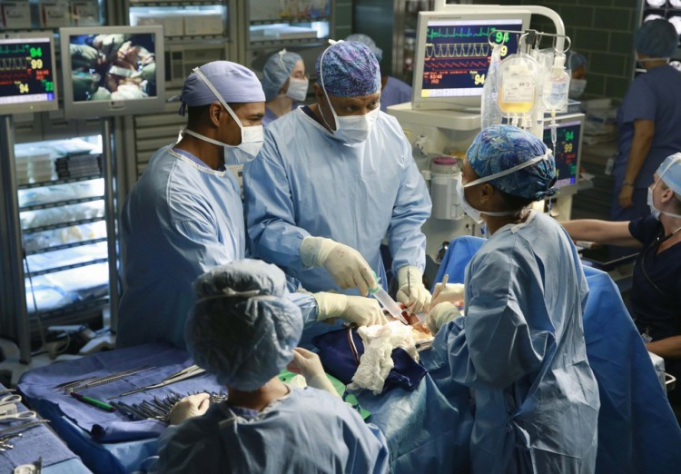
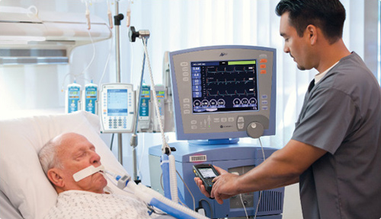
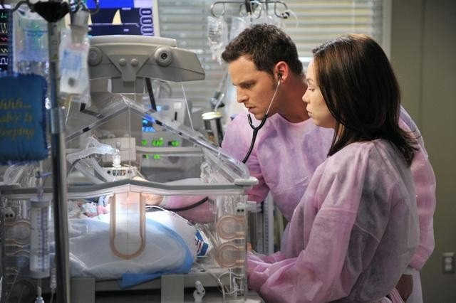
Where do RTs practice?
Primarily in Acute Care Settings
Administer Breathing Treatments
Emergency Departments – Trauma Team
Trach Patients
ICU - Managing Life Support - Ventilators
Operating Rooms
Neonatal ICU

Slide 6
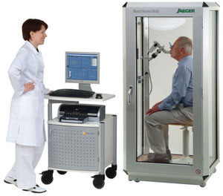
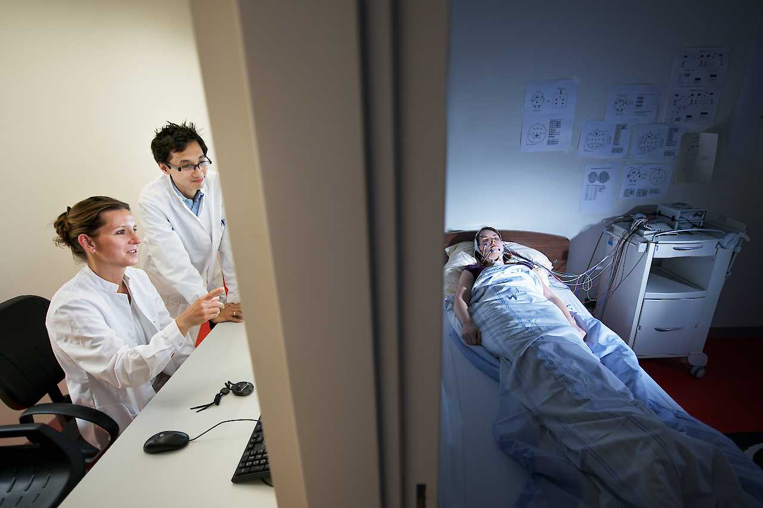
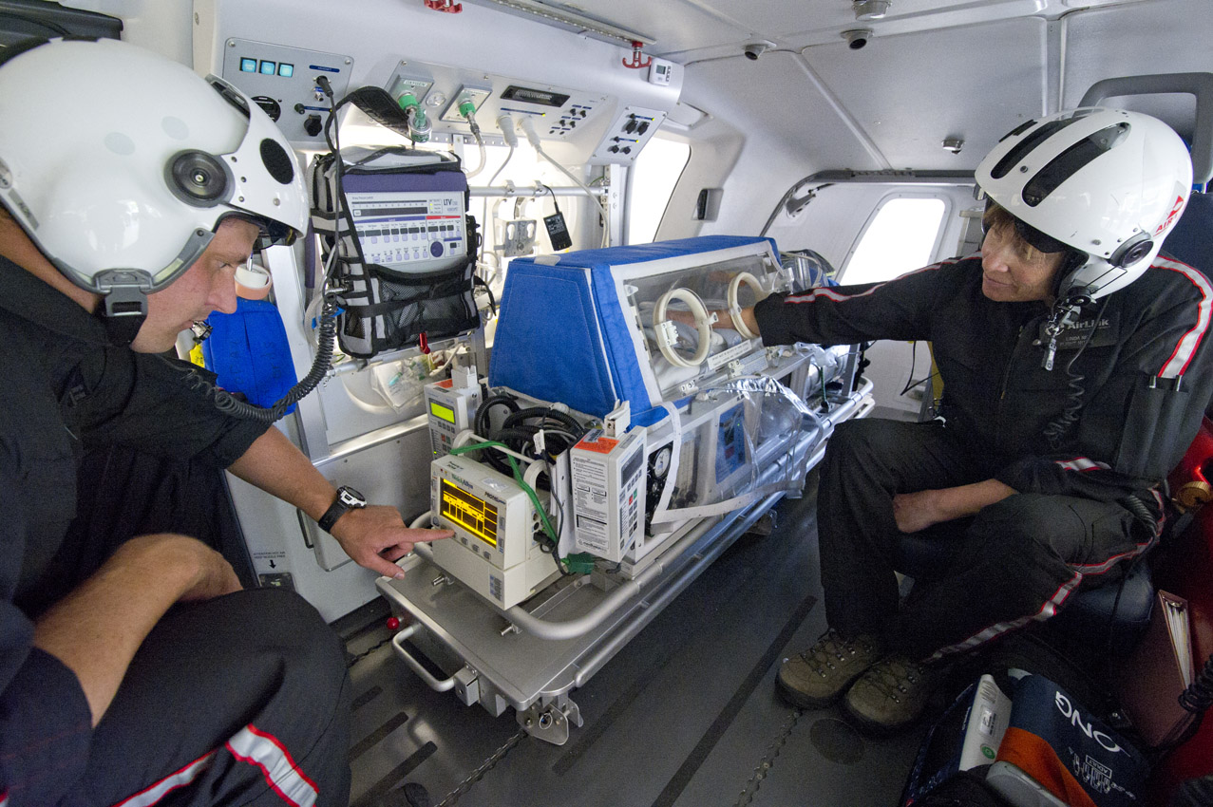
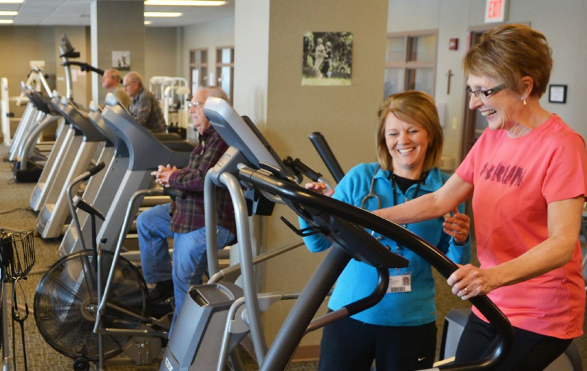
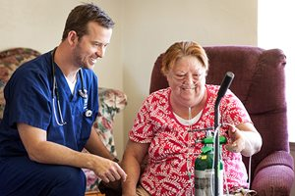

Other Areas of Practice for RRT
Pulmonary Function Testing
Sleep Labs
Emergency Transportation - Helicopters
Smoking Cessation and Asthma Education Programs
Pulmonary Rehabilitation
Home Care

Slide 7

Why Choose Respiratory Care?
Job growth projected at 23% (2016–2026)
High demand in Ohio
Median salary: $77,960/year ($37.48/hour)
  Weekend/Nights/Holidays earn extra $$
Sign-on bonuses and travel opportunities
Tuition Reimbursement for Professional Growth
Ref - Bureau of Labor and Statistics Occupational Handbook

Slide 8
Program Options
Full-Time: 5 semesters, on campus or in clinic, 4–5 days/week
Part-Time: 8 semesters, on campus or in clinic, 2–3 days/week
Both Options are held during business days, Monday-Friday. Admission Requirements are the same for both options.

Slide 9
Program Admission Steps
Apply to CSCC
  Take placement tests – Placement into STAT 1350 (MATH 1121) and ENGL 1100. Placement into “No Reading Required” or completion of a previous degree
Send Transcripts for transfer credit (must apply to the college first)
Make an appointment with an HHS advisor by emailing hhsadvising@cscc.edu
Apply to the Respiratory Care Program
Attend an information session and complete the information session quiz
Have a college-level GPA of 2.5 or better
  Courses that begin with 10xx will not be assessed in the cumulative GPA. GPAs are not rounded.
Register for NURC 1001
  Must earn a C or better or obtain “N” credit - See our Frequently Asked Questions page for eligibility on waiving the NURC 1001 requirement
Register for RESP 1110 and 1220

Slide 10
REP 1110 and RESP 1220
  Full-time candidates take these courses in the summer semester
  Part-time candidates take these courses in the autumn semester
  RESP 1220 has a co-requisite with BIO 2300 or BIO 1121. Please make sure you have either completed one of the biology courses or registered before you register for RESP 1220
  Candidates must be registered for RESP 1110 and 1220 at the time of the application deadline.
  Program admissions require both RESP 1110 and RESP 1220 to be passed with a 70% or greater
  Contact respiratory@cscc.edu for registration assistance and include your Cougar ID

Slide 11
Competitive Admission
Per our accrediting body, CoARC, the respiratory care program can accept up to 24 students for each cohort.
In rare circumstances, if the program receives more than 24 qualified candidates, the program will enter competitive admissions. However, there have been no competitive admissions since 2013
To learn more about our competitive admission process, visit our Frequently Asked Questions page on our website.

Slide 12

Important Application Dates
Full-Time Track Deadline Monday, March 31st
Part-time Track Deadline Monday, June 30th
Applicants are encouraged to complete an application before obtaining all admission criteria. The application will not be reviewed until after the deadline.
The deadline cannot be extended for any reason, so APPLY TODAY.

Slide 13
Program Acceptance:
Acceptance will be contingent upon:
  Completing both RESP 1110 and 1220 with a 70% or better.
  Completing NURC 1001 or obtaining “N” Credit
  Completing and passing a drug screen and background check
    Background screen and drug tests are approximately $116.74 *Cost subject to change without notice*
      For more information, visit Health Records: https://www.cscc.edu/services/health-records/background-drug-screening.shtml
      Students who have been contingently accepted into the program will be provided with information on how to complete this process. Do not complete this step prior to acceptance.
      Background and drug screens completed for NURC will not suffice program requirements. You will need to repeat the background for program admissions.
  Applicant must not have been banned from any local hospital system premises or denied access to participate in clinical activities by any such facility.

Slide 14
Plan of Study
General courses can be taken at any time
Technical courses (RESP ####) must be taken in sequence and require a 70% or higher to progress to the next course

Slide 15
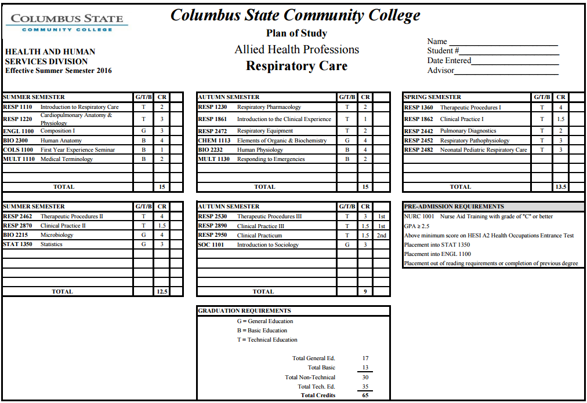
Full-Time Track Plan of Study

Slide 16
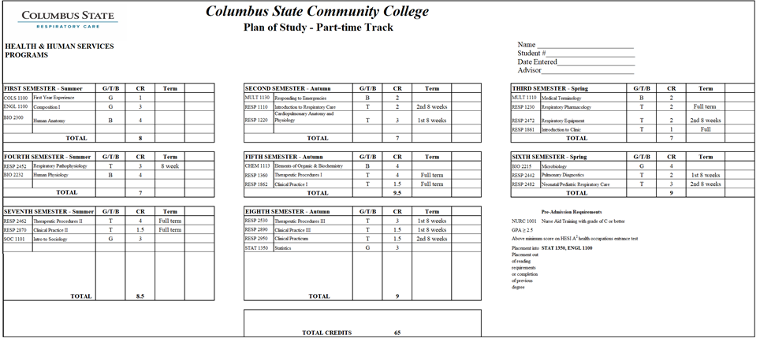

Part-Time Track Plan of Study
Click the stethoscope for a larger version

Slide 17
Plan of Study Course Substitutions
BIO 2300/2301 can be substituted for BIO 1121/1122
  The biology sequence must be completed; if you complete BIO 2300, you must complete BIO 2301, not BIO 1122
  If you complete BIO 1121, you must complete BIO 1122
  If you have a goal to earn your bachelor’s degree, it is highly recommended to take BIO 2300/2301
STAT 1350
  MATH 1148
  MATH 1109
    Non-transferable course and not recommended for students who wish to pursue a bachelor’s degree.
SOC 1101
  PSY 1101

Slide 18
Technical Courses
Upon acceptance to the respiratory care program, students will be enrolled in technical courses automatically.
  Students must successfully achieve a 70% or greater in all technical courses or a grade of “S” in clinic courses to continue in sequence.
Technical courses are lock and key, meaning each course is a prerequisite for the next course. You must take them in order as laid out in the plan of study.
Technical courses are offered at a minimum of once a year.
Students have two opportunities to complete the program upon acceptance.
  RESP 1110 and 1220 do not count as an attempt (these courses must be completed prior to final acceptance into the program and can be taken multiple times).
  Students are unable to progress if a student earns less than a 70% in technical courses or a “U” in clinical clinics.
  Withdraws at any time after accepting a seat into the program count as an attempt.

Slide 19
Program Re-entry Policy
After successfully completing RESP 1110 and RESP 1220 and receiving final acceptance into the program, a student who leaves the program for any reason and is eligible to return must re-enter during the first clinical course, RESP 1861, and the tagged equipment and therapeutic course. The student will continue with clinical courses until back in sequence with the plan of study.
For example, if a student in the full-time track earned less than 70% in RESP 2442 (Pulmonary Diagnostics), but passed all the other respiratory courses that semester, they could not progress with their cohort. That student will re-enter and retake RESP 1861 and its paired equipment course, RESP 2472, in the autumn semester—even if both were previously passed. In the spring semester, the student would then complete RESP 2442 (the failed course), RESP 1862, and RESP 1360. RESP 1862 is tagged with RESP 1360 and must also be taken as a pair. The student would not have to repeat RESP 2482 and 2452
Note: In accordance with Ohio Department of Higher Education requirements, each clinical course is paired with a corresponding therapeutics or equipment course. These paired courses must be repeated together, regardless of any previous passing grade. Financial aid may not cover the cost of successfully completed courses taken again. It is the student’s responsibility to confirm their financial aid eligibility for repeated coursework

Slide 20
Clinical Experience
Students will have the opportunity to rotate through the 4 major health systems in Columbus
  Ohio Health -Doctors Hospital, Grant Medical Center, Riverside Methodist Hospital
  Mount Carmel Health Systems (Trinity Health) -Mount Carmel East, Mount Carmel St. Ann’s, and Mount Carmel Grove City
  Nationwide Children’s Hospital
  OSU Wexner Medical Center -OSU East and OSU Wexner Main Medical Center
Supervised by CSCC instructors
  A 6:1 student-to-instructor ratio is maintained to ensure quality clinical instruction. Instructors guide clinical experiences to align with classroom learning, and students are assigned patients who are receiving the therapies currently being covered in their coursework.
Rotations can begin as early as 5:30am and end as late as 7:15pm
Students are responsible for arranging transportation to clinic
Students are encouraged to have health insurance, as they may be exposed to illnesses, draw blood, and perform therapies that carry some risk of occupational hazards.

Slide 21
Ongoing requirements of the program
Maintaining a current BLS for a healthcare provider
Maintaining immunization records or waivers, and receiving the annual flu vaccination
  Check with Health Records regarding expiration: https://www.cscc.edu/services/health-records/immunizations-tuberculosis-TB.shtml
  If you started a health record for NURC, you will need additional vaccinations to meet program requirements.
Complete all required computer training and requirements for clinical hospital affiliates

Slide 22
Health Records
The Respiratory Care program health records differ from NURC, you will have to add to your health record.
To verify health record requirements, you must contact Health Records.
  Program faculty do not view or receive any student personal health information
We do not waive health records.
Instructions on Submitting Health Records

Slide 23
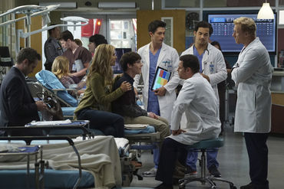
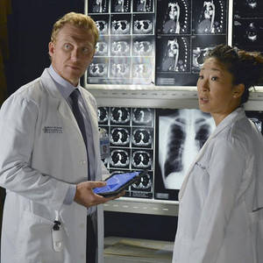
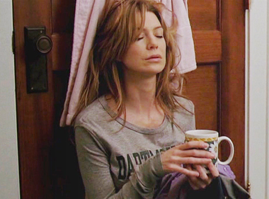
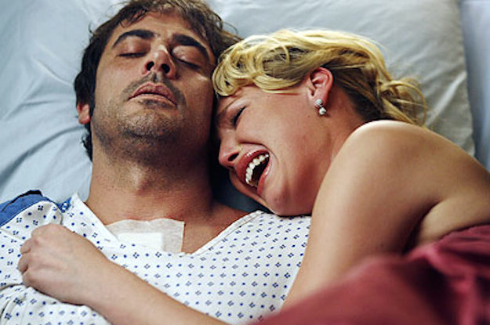

Skills a RRT Student needs
Communication
Critical Thinking
Perseverance
Empathy
Collaboration

Slide 24
Program Costs
Costs not applicable to financial aid nor covered by lab or tuition fees
College application, records, and ID fee: $50
65 credits hours x $182.93 (2025 rate) = $11,890.45 *Ohio Residents
Books: approximately $500
Lab Fees: approximately $200
Background and Drug Screen: $116.74 (subject to change without notice)
Health Record: ~$50 (cost varies based on personal health insurance)
Other academic fees (technology and facilities fee and online course fee: $0-$150 based on credit hours and class format)
$165.00 RESP 1861 clinical documentation system (one-time purchase)
$235.00 RESP 2482 for the Neonatal Resuscitation Provider exam
$20.00 RESP 2530 for the Advanced Life Support card
$465.00 RESP 2950 Autumn Semester Kettering Review
Students are responsible for covering these additional costs at the beginning of the semester.
*These figures are subject to change without notice

Slide 25
Financial Aid, Grants and Scholarships
Financial aid may be available to students who qualify.
You may be eligible for financial aid, grants, and/or scholarships.
Declare your major as “Health Science degree” with your intended program of study as “Respiratory Care.”
Please visit the following webpages for more information:
  https://www.cscc.edu/services/financial-aid/
  https://www.cscc.edu/services/financial-aid/types-of-aid/scholarships.shtml

Slide 26
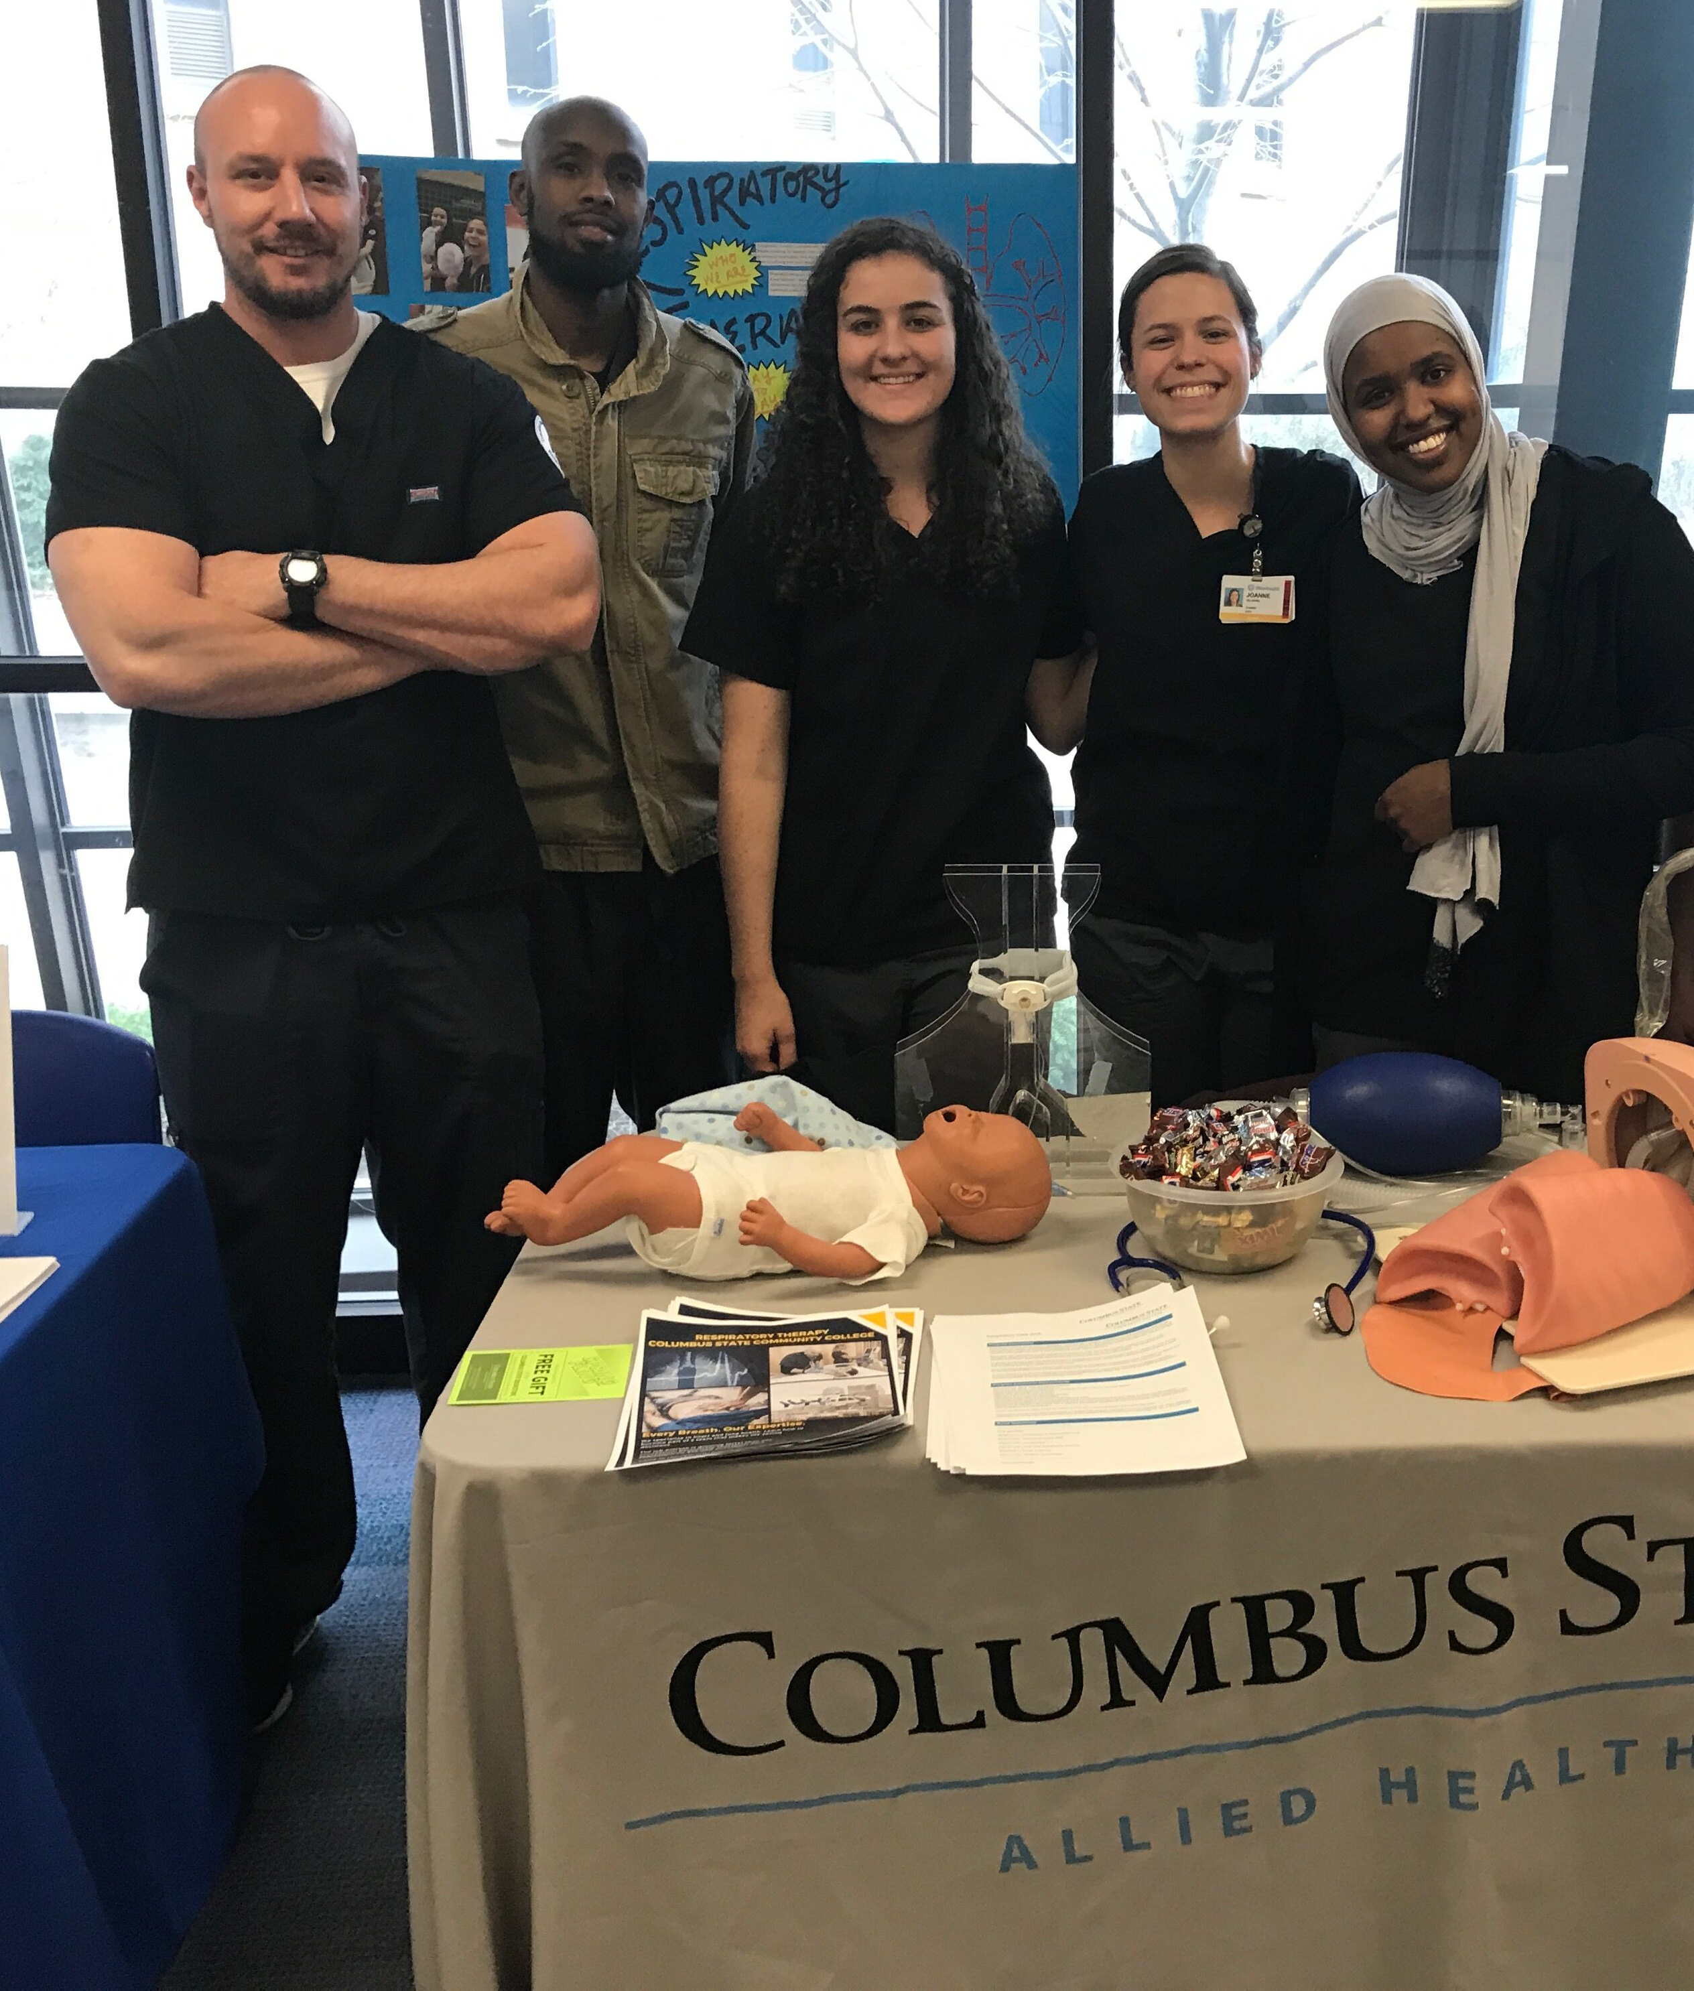
Dress Code
Upon acceptance to the respiratory care program, students will be required to adhere to the program dress code in lab and in clinic.
Wear black scrub tops and pewter scrub bottoms.
  Scrubs can be purchased with financial aid money at the campus bookstore.
White or black leather shoes
Watch with a second hand
One earring stud per ear
Wedding set or one ring per hand
No visible tattoos
  Can be covered with sleeves or Band-Aids
Hair must be of a traditional color

Slide 27
RRT Student Tips for Success
Technical courses are more rigorous than general and basic courses. Students should plan to spend 2-3 hours studying for each hour they are in class; this does not include time to complete homework. You are not studying for a test; you are studying to save a LIFE!
All lectures are online. Students should develop a routine that allows them time to study the lecture material prior to attending in-person labs.
Labs are conducted in person on main campus. Students are expected to attend all scheduled labs, as there is a program attendance requirement. Arriving 5 minutes late or leaving 5 minutes early counts as an absence.
Labs are used to demonstrate the skills learned from the online lecture. Students who do not complete the online lecture will struggle to pass the laboratory requirement of the course.
Successful students spend additional time outside of their scheduled lab time to practice with equipment in the lab to prepare for competency or skill assessments.

Slide 28
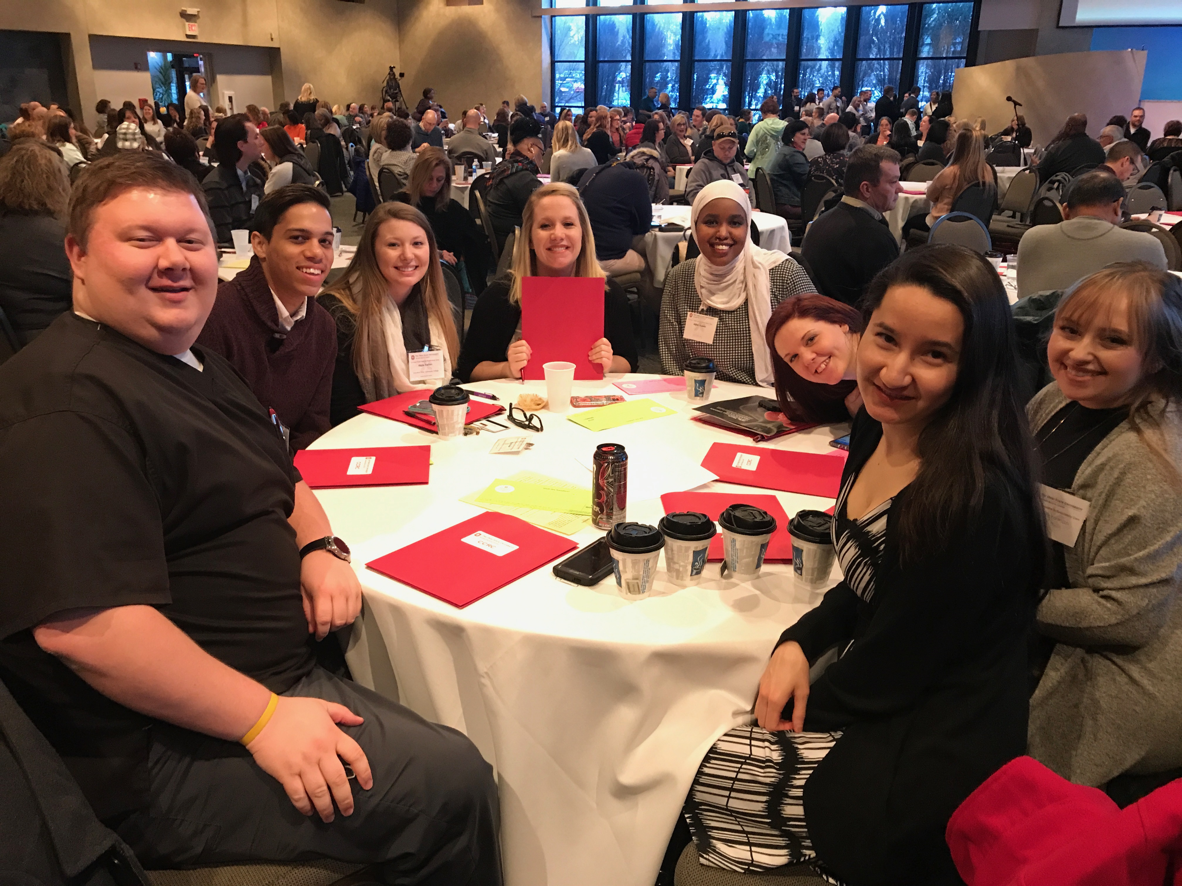
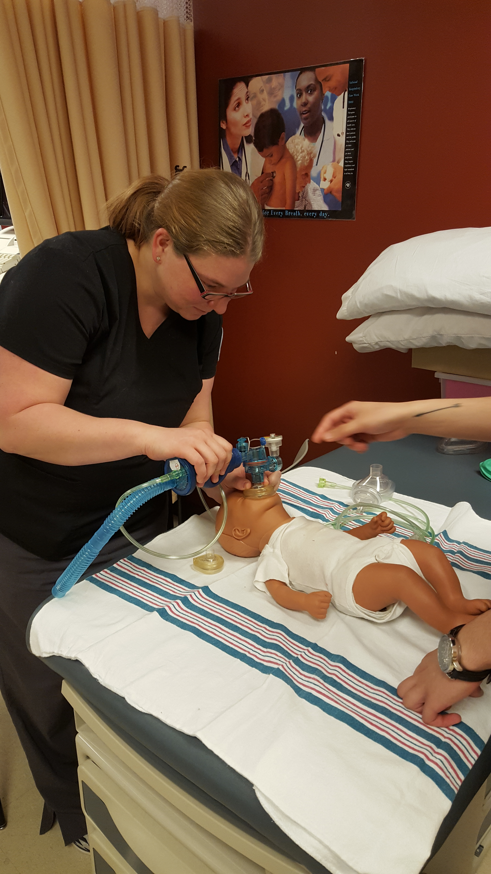
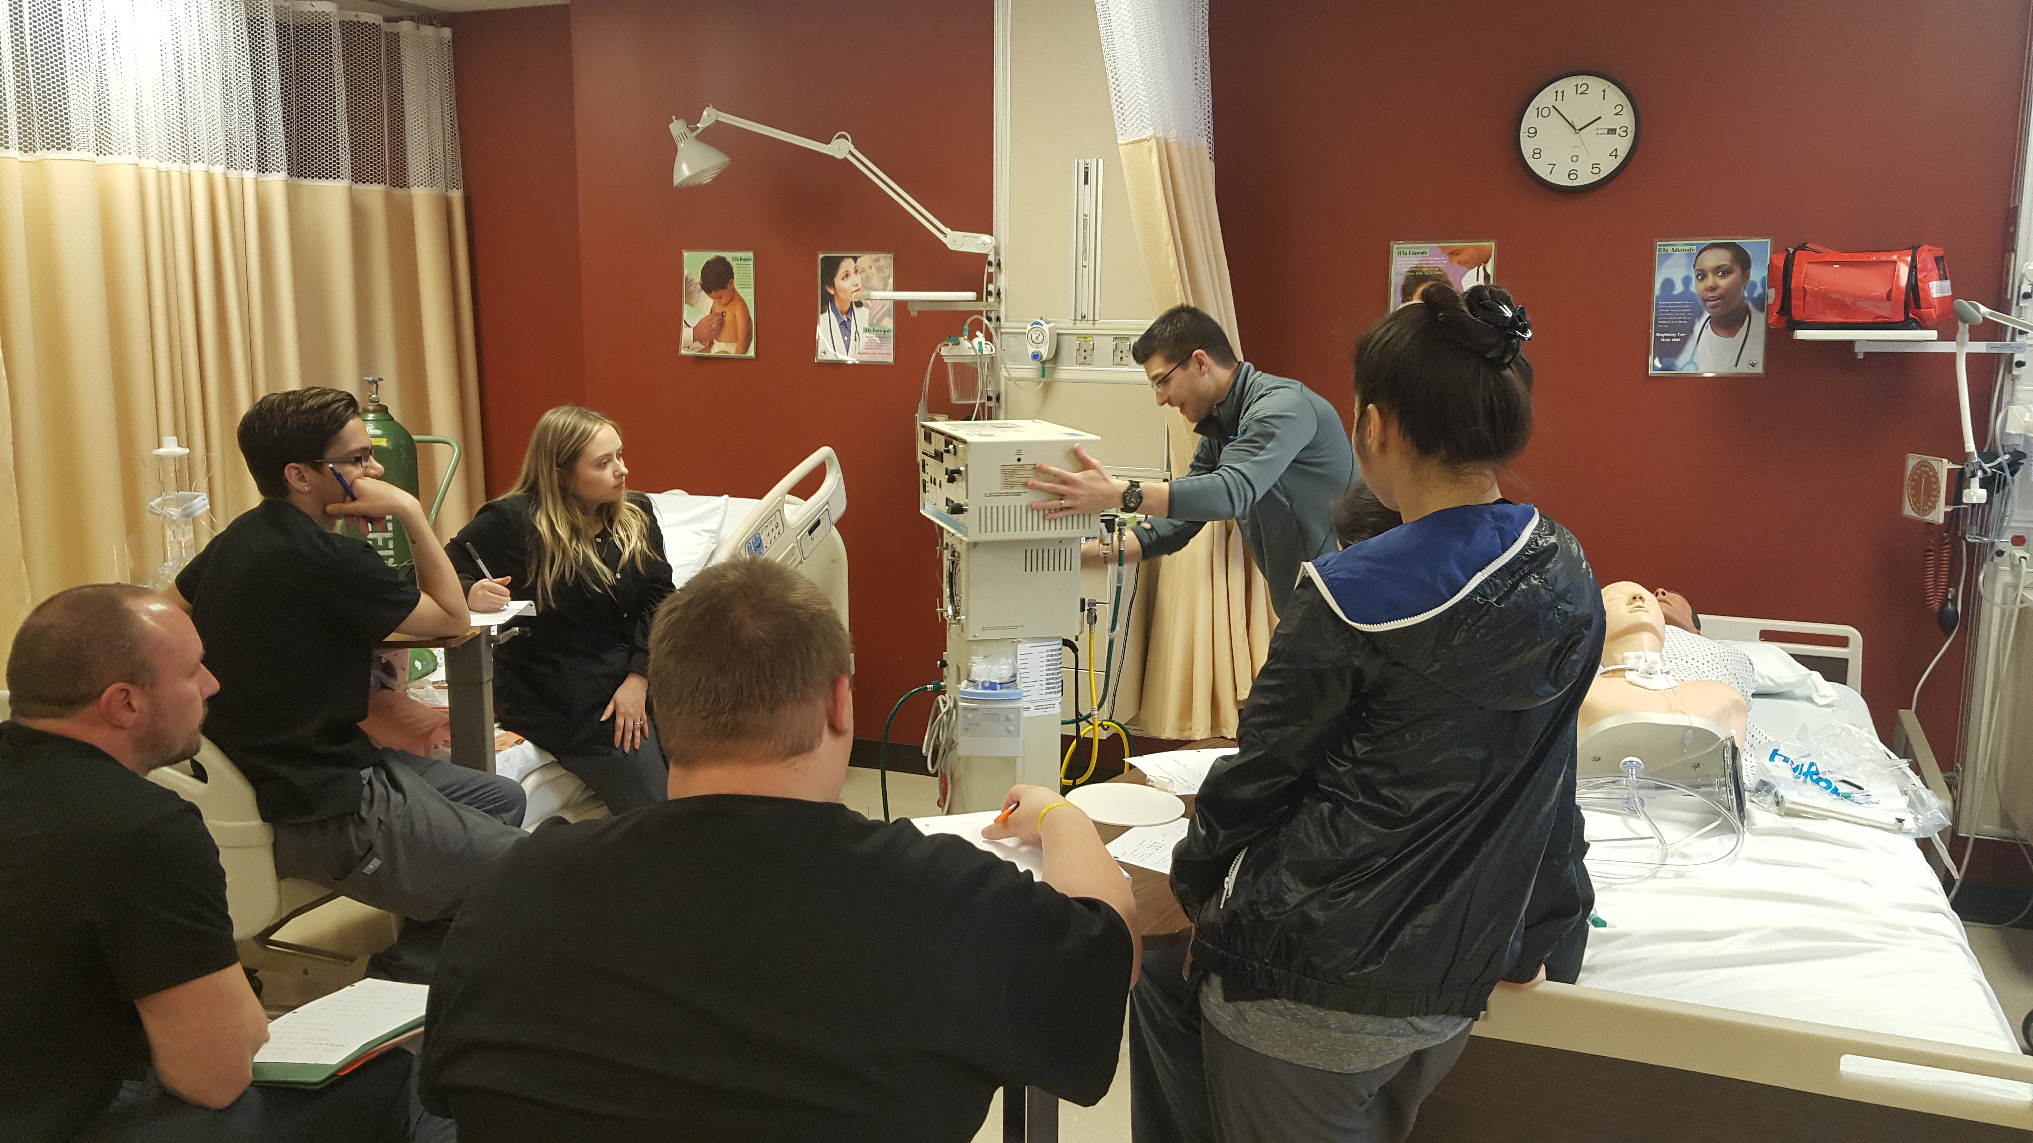
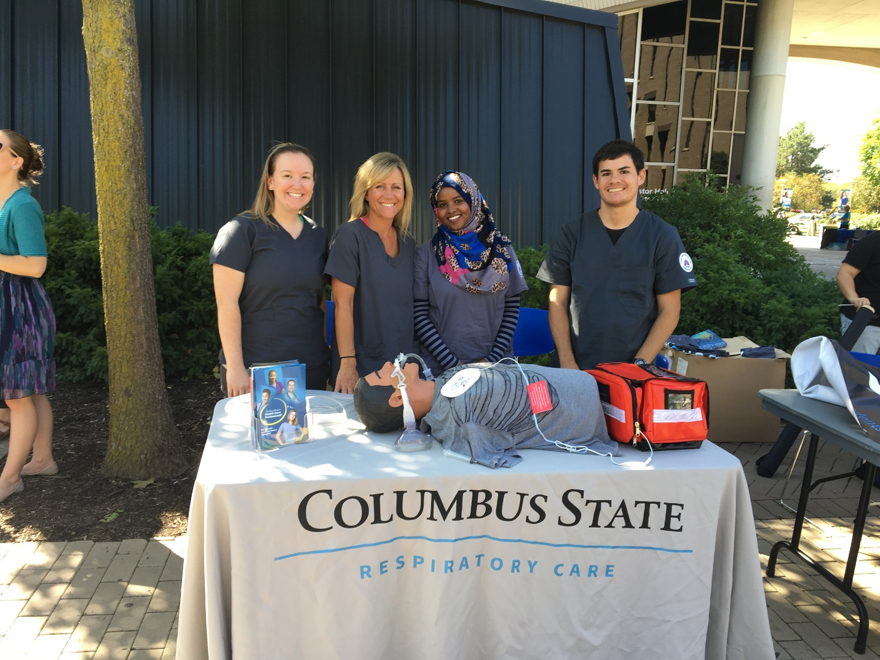
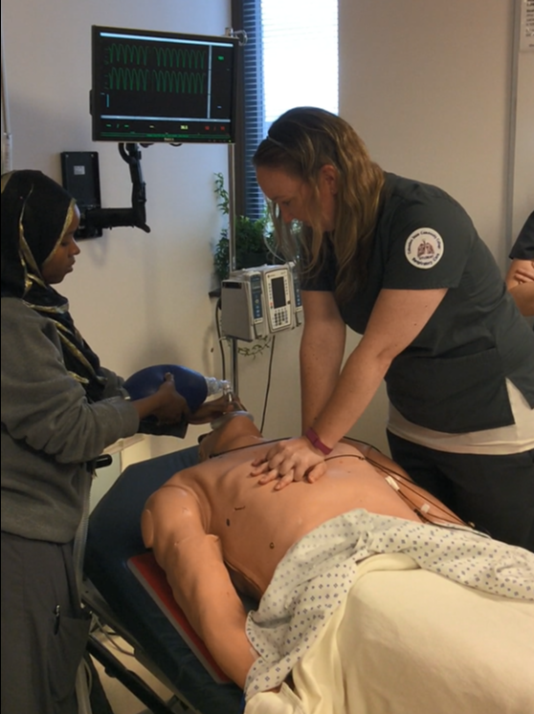
Class Opportunities
Attending Conferences
Small Learning Groups
Hands-on Labs
Career Fairs
Simulations

Slide 29
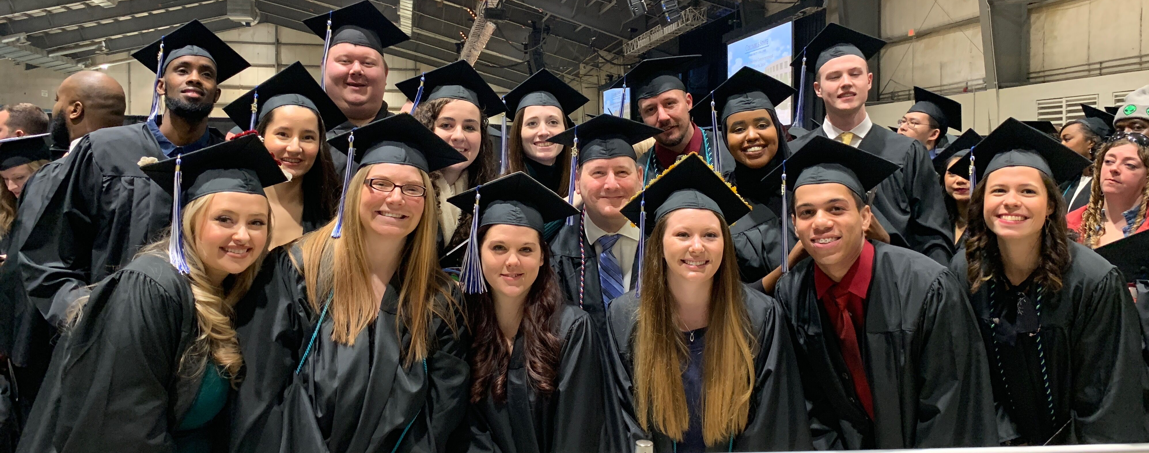
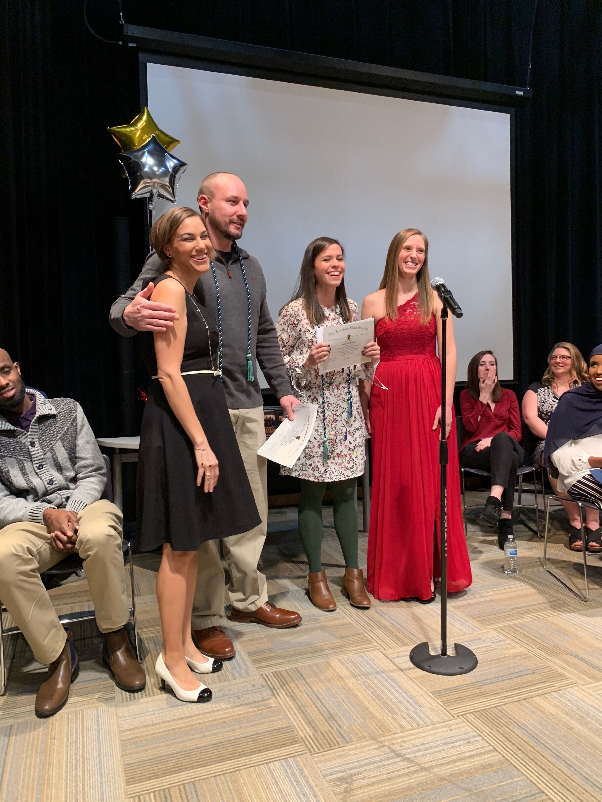
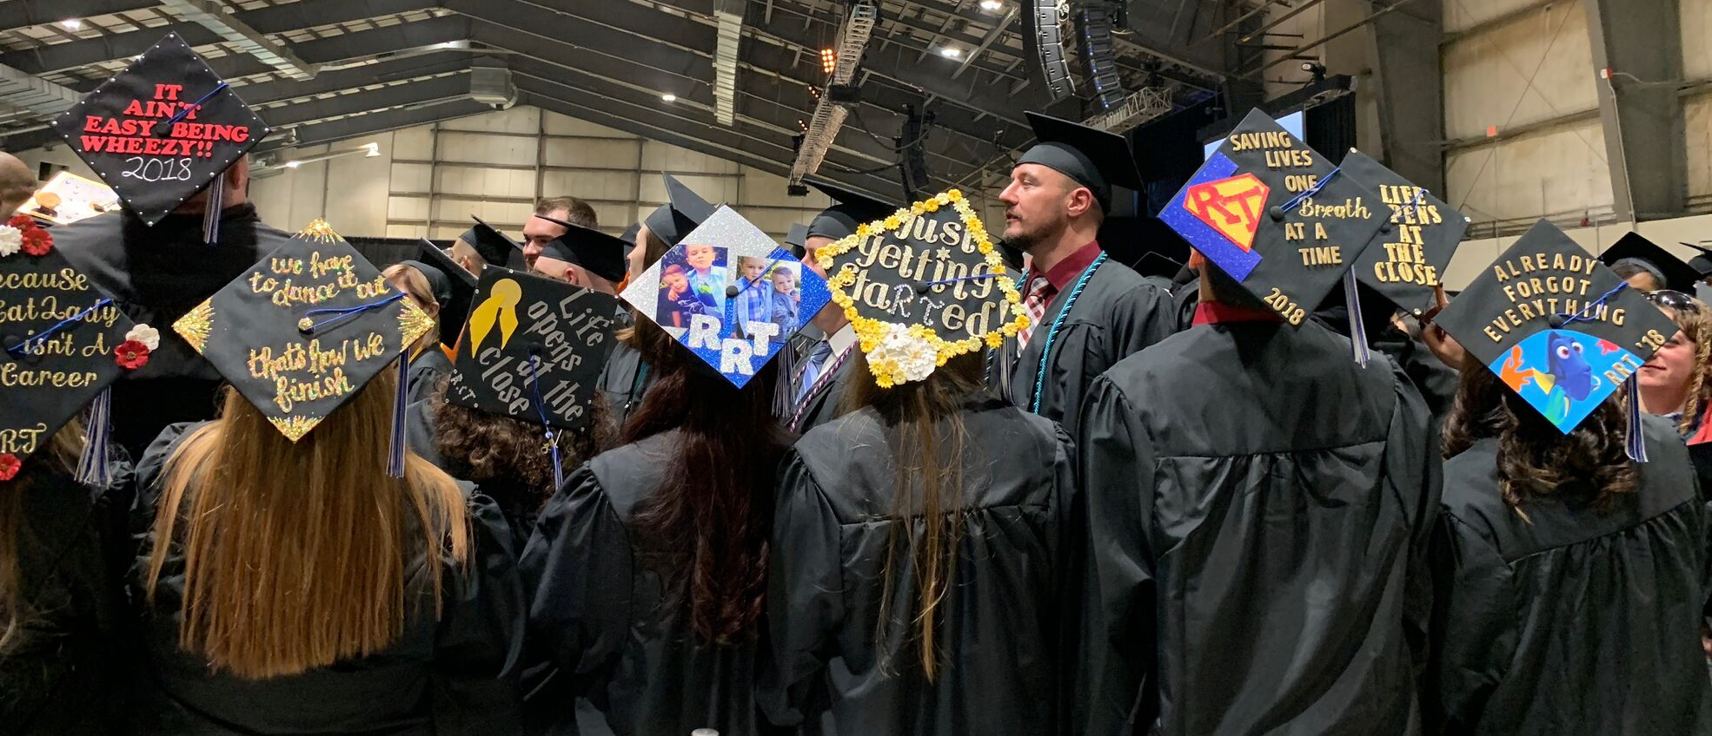
Graduation and Celebrations

Slide 30
Post Graduation
National Credentials
State Licensure

Slide 31
Post Graduation Requirements
National Board of Respiratory Care
  Credentialing Exams
    The Respiratory Therapy Examination
Ohio Medical Board - State Licensure
  RRT credential is required to practice in the state of Ohio
  Application fee (~$75)
  Background check (~$70)
  *these costs are subject to change without notice

Slide 32
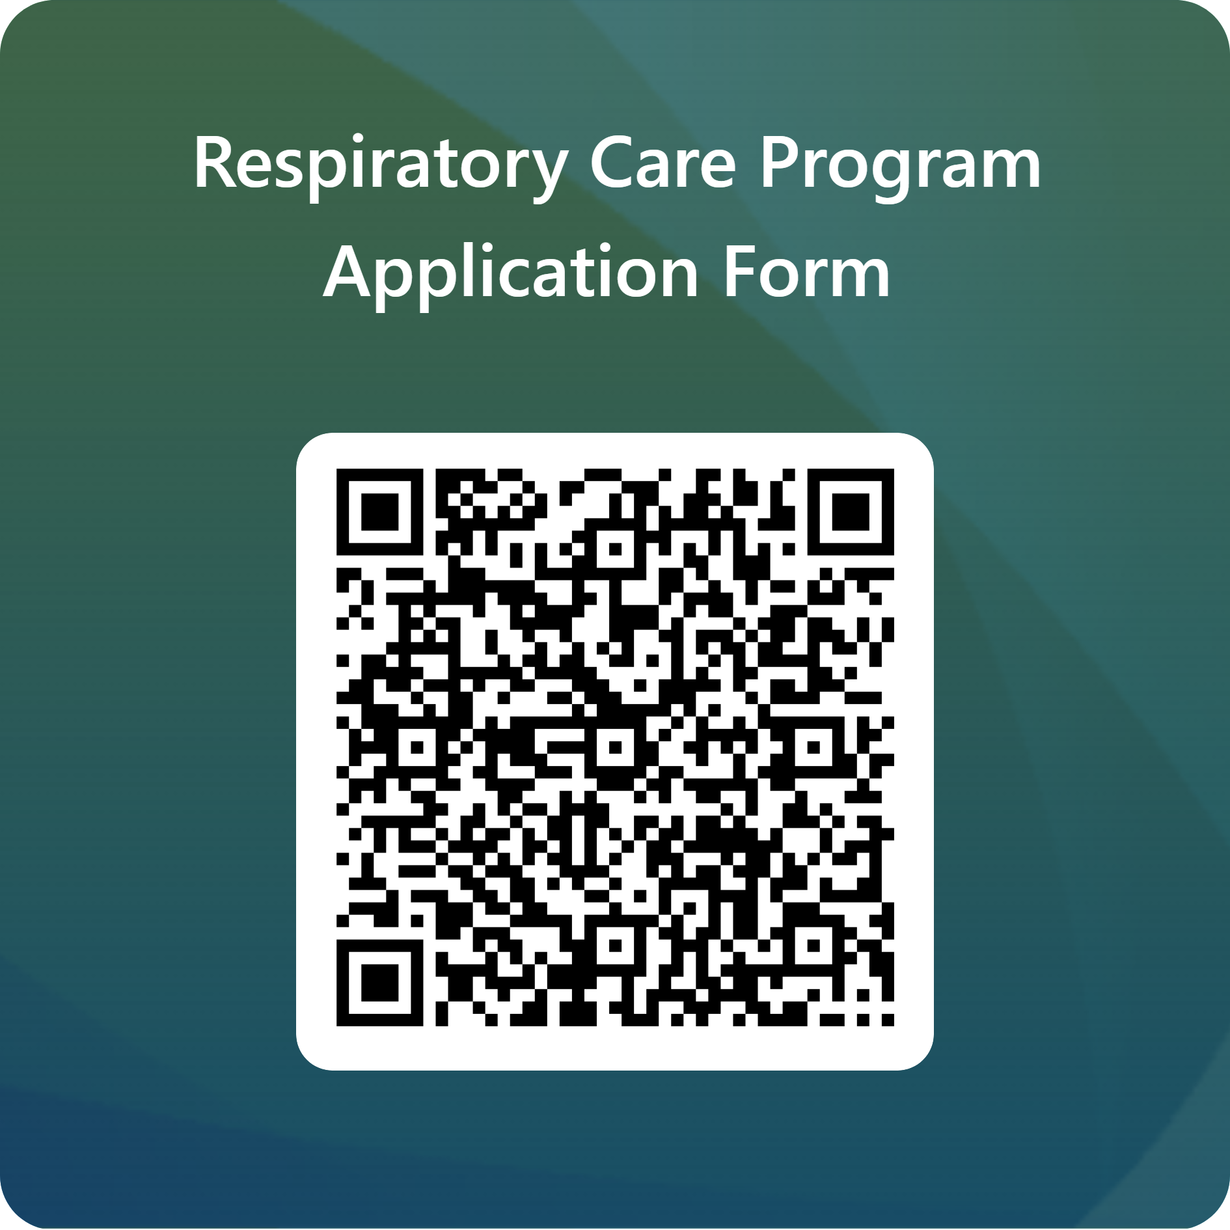
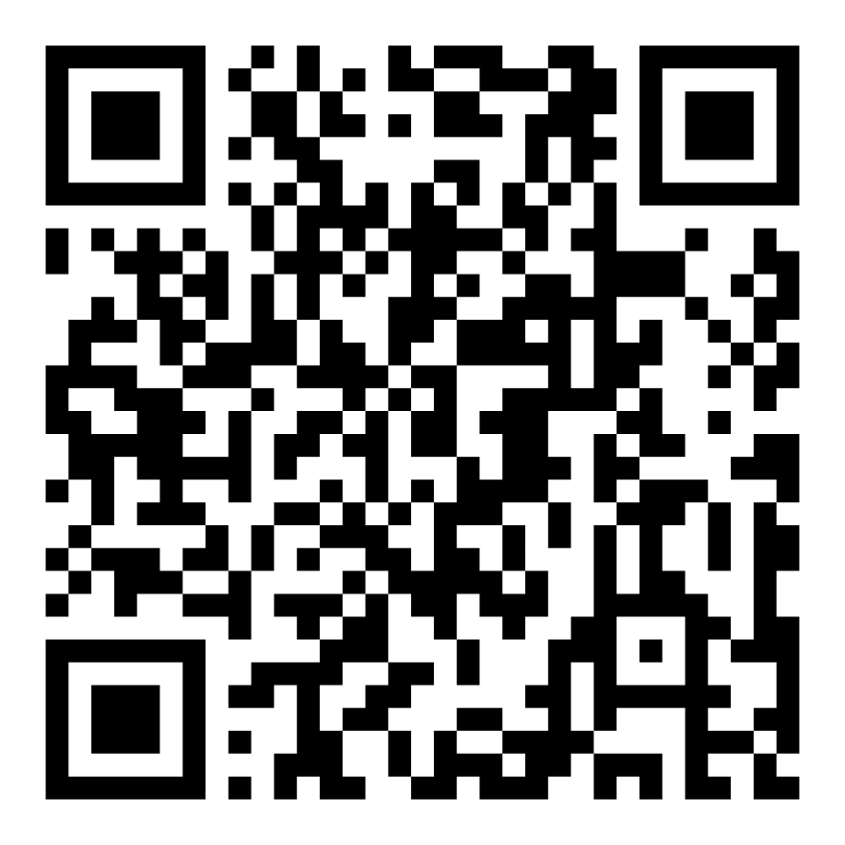
Next Steps
Apply Today!
Take the Information Session Quiz Now!
Remember…
Full-time track Deadline March 31st
Part-time track Deadline June 30th
Application Deadlines cannot be extended for any reason

Slide 33

Questions?
Thank you for your interest in the
Respiratory Care Program.
We look forward to reviewing your application!
Frequently Asked Questions
For general program application questions, please contact respiratory@cscc.edu
For advising questions, please contact hhsadvising@cscc.edu

